Slide 1
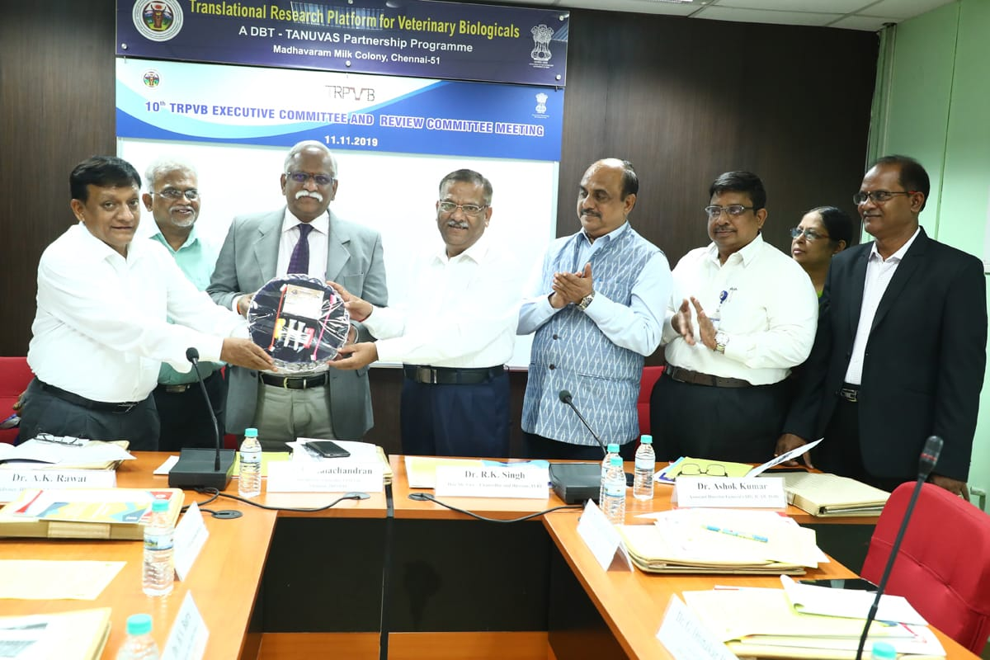
Dr. C. Balachandran, Hon’ble Vice Chancellor, TANUVAS ; Dr. R.K. Singh, Hon’ble Vice-Chancellor & Director, IVRI and Dr. A.K. Rawat, Adviser, DBT, Co-Chairman, TRPVB-EC releasing CaniPRO Gel developed at TRPVB during the 10th Executive Committee meeting held on 11.11.2019. Others present include Dr. V.A. Srinivasan Adviser NDDB and Former MD, IIL, Hyderabad ; Dr. Ashok Kumar, Assistant Director General, ICAR (Animal Health), New Delhi ; Dr. C.G. Joshi, Director, GBRC, Gujarat (EC Member) ; Dr. G. Dhinakar Raj, Director, Centre for Animal Health Studies, TANUVAS ; Dr. Cecilia Joseph, Director of Research i/c, TANUVAS ; Dr. Tensingh Gnanaraj, Registrar, TANUVAS and Dr. M. Raman, Project Director i/c, TRPVB-TANUVAS

Slide 2
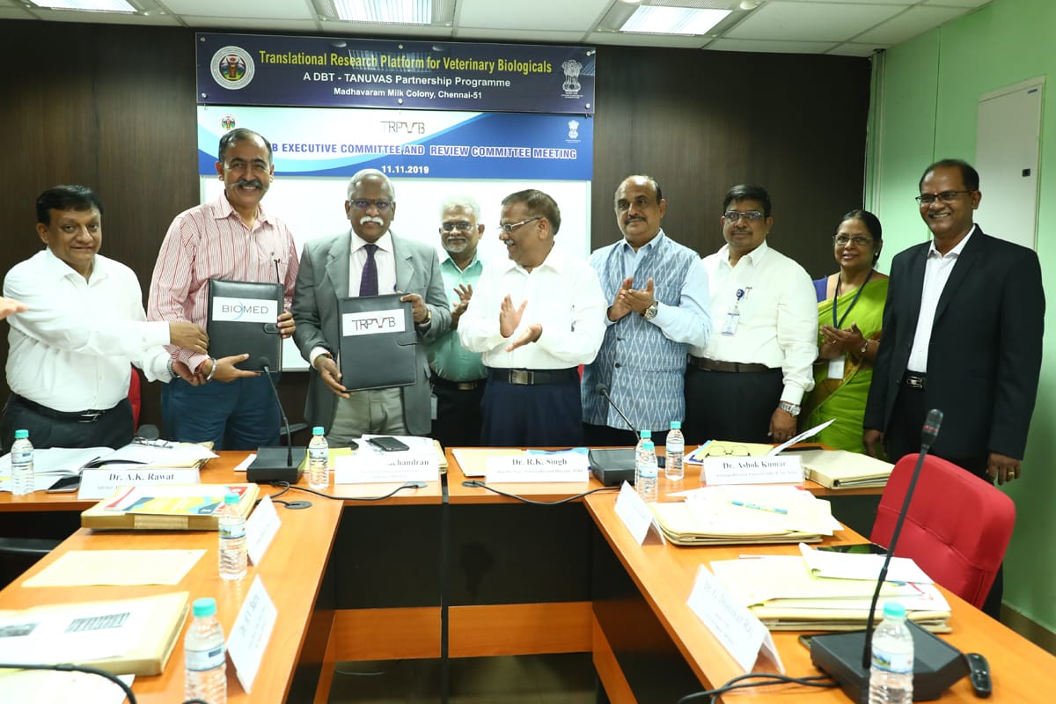
Dr. C. Balachandran, Hon’ble Vice Chancellor, TANUVAS and Mr. Sanjeev Naayar, M/s. Biomed, USA exchanging MoU for the Inpouch TF Kit manufacturing; during the 10th Executive Committee and Review Committee Meeting held at TRPVB Conference Hall on 11.11.2019

Slide 3
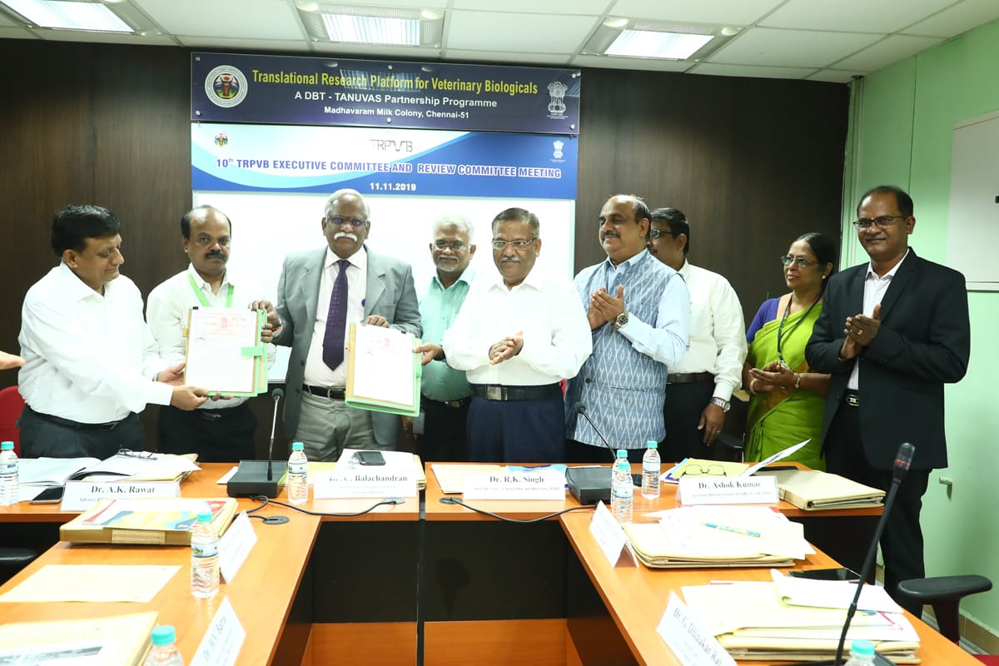
Dr. C. Balachandran, Hon’ble Vice Chancellor, TANUVAS and Dr. S. Ramamoorthy, CEO, M/s.Palamur Biosciences, Hyderabad exchanging MoU for the transfer of CPV VLP Technology ; during the 10th Executive Committee and Review Committee Meeting held at TRPVB Conference Hall on 11.11.2019

Slide 4
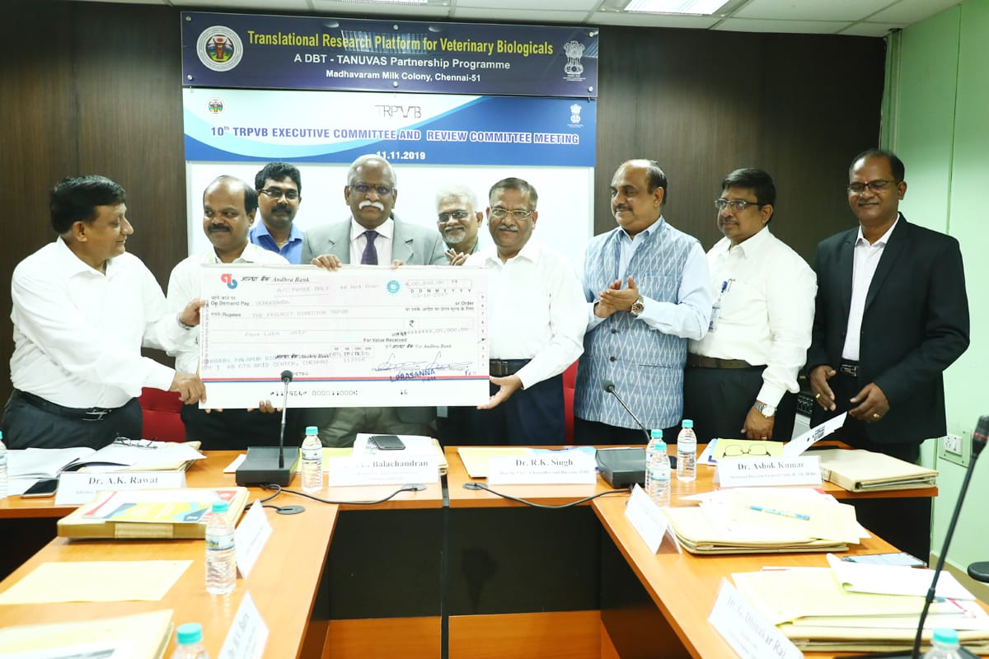
Dr. C. Balachandran, Hon’ble Vice Chancellor, TANUVAS is receiving a cheque for Rs.4,00,000/- as tech transfer fee from Dr. Ramamoorthy, CEO , M/s. Palamur Biosciences, Hyderabad for the transfer of CPV VLP technology during the 10th Executive Committee and Review Committee Meeting held at TRPVB Conference Hall on 11.11.2019

Slide 5
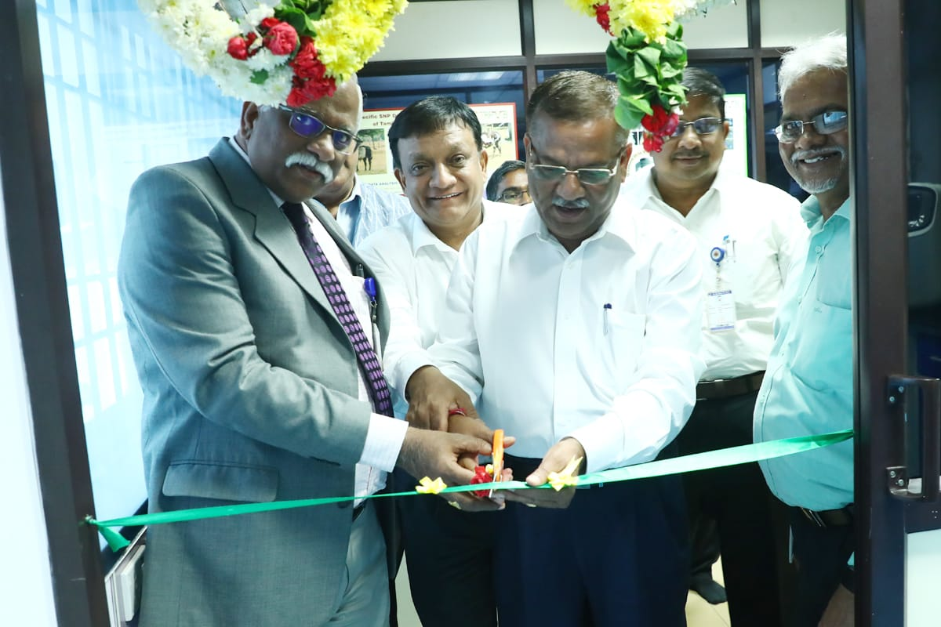
Dr. C. Balachandran, Hon’ble Vice Chancellor, TANUVAS ; Dr. R.K. Singh, Hon’ble Vice-Chancellor & Director, IVRI and Dr. A.K. Rawat, Adviser, DBT, Co-Chairman, TRPVB-EC inaugurated the Next Generation Sequencing (NGS) facility at TRPVB – TANUVAS on 11.11.2019

Slide 6
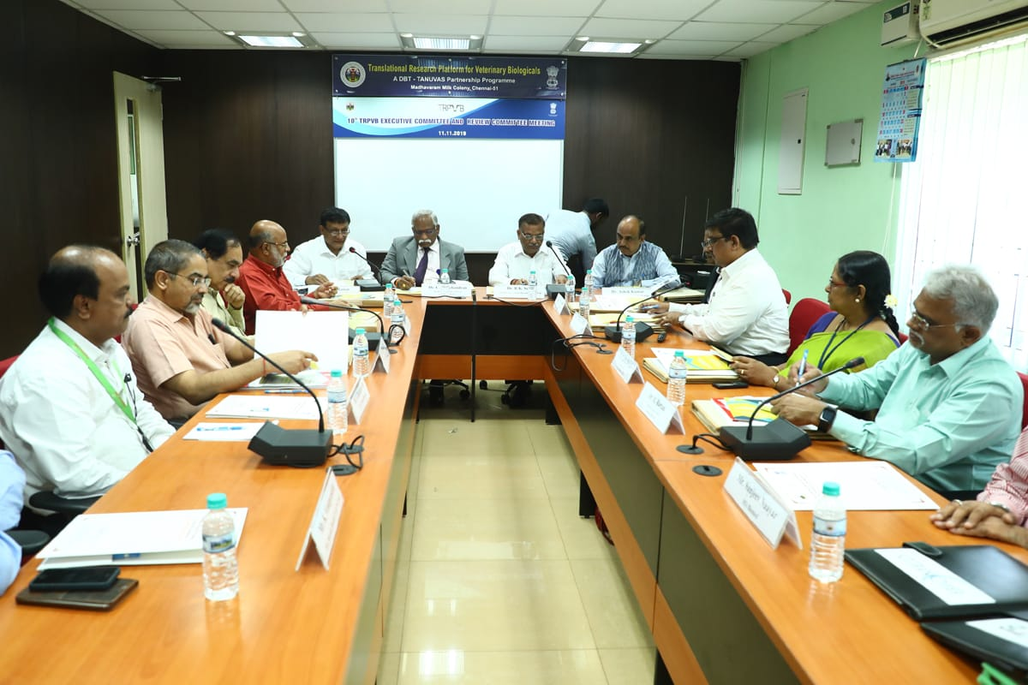
11.11.2019 Tenth TRPVB Executive Committee and Review Committee Meeting in progress

Slide 7
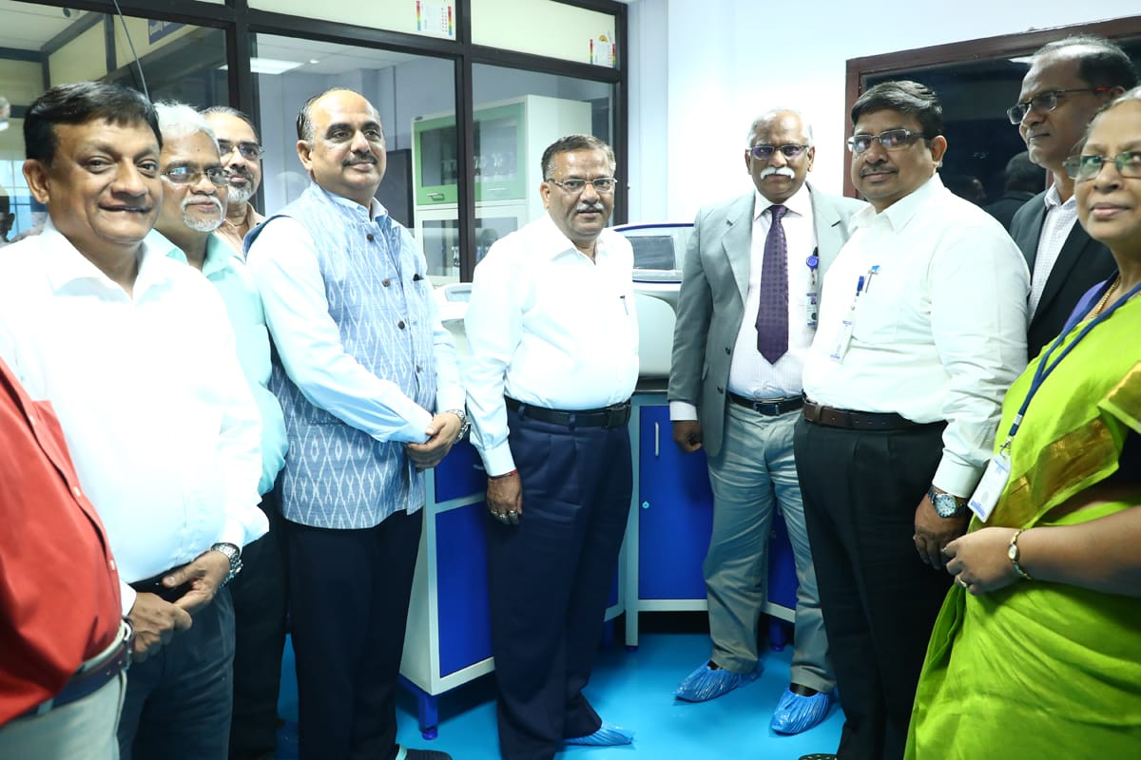
Dr. C. Balachandran, Hon’ble Vice Chancellor, TANUVAS ; Dr. R.K. Singh, Hon’ble Vice-Chancellor & Director, IVRI and Dr. A.K. Rawat, Adviser, DBT, Co-Chairman, TRPVB-EC inaugurated the Next Generation Sequencing (NGS) facility at TRPVB – TANUVAS on 11.11.2019

